Slide 1
Programming Concepts III
HILT 2016

Slide 2
What is OOP?
Objects are complex entities (which we sometimes call "data structures") with qualities and abilities.
In an object-oriented programming language, we work with complex objects rather than simple "primitives" like numbers and strings.

Slide 3
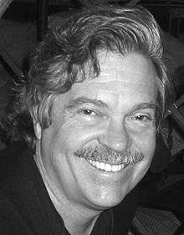
Object Orientation
(Nearly) Everything is an Object
Objects "communicate" by sending and receiving messages
Objects have their own memory
Every object is an instance of a class
Alan Kay
Object-oriented Programming
Graphical User Interface
3D Graphics
ARPANET (what became the Internet)

Slide 4
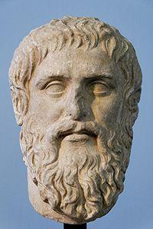
Classes and instances
Classes are archetypes
Instances are particular objects
Notes:
Ethan and Brandon are both instances of class Human.
It’s a way of organizing and understanding the relationships among groups of things.

Slide 5
Class
Describes the generic characteristics of a single type of an object
What things are of this type are
Dog
Vehicle
Baby

Slide 6
Classes and Instances
Classes
Template for an object
Describes state
Describes behavior
Used to create many instances
Instances
Discreet instantiation of a class
Shares behavior with other instances
Notes:
Classes are the abstract template.
Instances are single units. Have all the behaviors of a class.

Slide 7
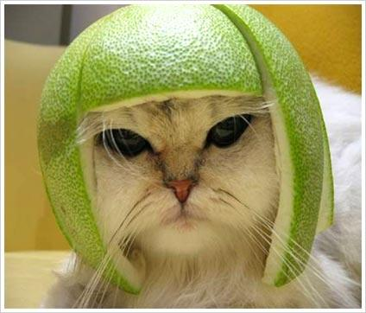
Object
Take this cat…
It has qualities (attributes)
white
long-haired
4 years old
And can do things (methods)
walk
eat
meow
nap

Slide 8
Methods
Defines a behavioral characteristic
What the things of the class's type do.
Chase
Drive
Talk
The "verbs"

Slide 9
Methods
Defined within a class
Store instructions to execute on attributes
keywords def and end start and end a method
Every method evaluates to something
return keyword not required
last statement
use # at the beginning of a line to write a comment (Ruby will ignore everything on the line after the #)
Exception?
"#{variable}"

Slide 10
Variable
Defines attribute characteristics
What things of the class’ type have
Breed
Model Year
Favorite Ice Cream

Slide 11
Instance
A specific incarnation of a class
Rin Tin Tin
garbage truck
the neighbor's kid

Slide 12
Coffee Class
class Coffee
end
c = Coffee.new
puts c
#<Coffee:0x007ffb1d0b6290>
=> nil
Notes:
Coffee class with nothing in it.

Slide 13
Coffee Class
class Coffee
def initialize
puts "Coffee is created"
end
end
c = Coffee.new
Coffee is created
=> #<Coffee:0x007ffb1d09ba08>
Notes:
Initialize class is what happens when something new is made

Slide 14
Coffee Class
class Coffee
def initialize
@temperature = 0
@flavor = 'sweet, smoky, Sumatran’
end
end
myCoffee = Coffee.new
=> #<Coffee:0x007ffb1d025cb8 @temperature=0, @flavor="sweet, smoky, Sumatran">

Slide 15
Coffee Class
class Coffee
def initialize(temp = 0, flavor = 'bland')
@temperature = temp
@flavor = flavor
end
end
waynes_coffee = Coffee.new(80, 'spicy')
=> #<Coffee:0x007ffb1b8219c8 @temperature=80, @flavor="spicy">
brandons_coffee = Coffee.new(90)
=> #<Coffee:0x007ffb1d0f0030 @temperature=90, @flavor="bland">

Slide 16
Variable Scope
local variable
temperature
instance variable
@temperature
class variable
@@temperature
global variable
$temperature
constant
TEMPERATURE
Notes:
Different variable types only activate in certain parts of a code. Remember the do block with |fruit|? Fruit cease to exist outside that do block. We can organize the access of information in our code. Organization is your best defense against bugs.

Slide 17
Manipulating Values
Use the "!" operator
def temp!(temp)
@temperature = temp
end
myCoffee.temp!(120)
puts myCoffee.temp
yourCoffee = Coffee.new
puts yourCoffee.temp

Slide 18
Existential Operator
def hot?(temp)
if temp > 160
return true
end
false
end

Slide 19
Method Chaining
Do a series of tasks in order (left-to-right)
task.try.tryAgain.success?
First, task.try executes, then result.tryAgain
task.try.tryAgain.success?
result.tryAgain.success?
result.success?

Slide 20
Inheritance
A relation between two classes
Cats are mammals, all mammals are animals
Classes lower in the hierarchy 'inherit' features
If all mammals can breathe, then all cats can breath
Only one level of inheritance!!!
class < parent

Slide 21
Inheritance
class Drink
def initialize
@container = 'can'
@material = 'aluminum'
end
def get_container
@container
end
def get_material
@material
end
end
class Coffee < Drink
def initialize
@container = 'mug'
@material = 'ceramic'
@flavor = 'sumatran'
end
def get_flavor
@flavor
end
end
myCoffee = Coffee.new
puts "The #{myCoffee.get_material} #{myCoffee.get_container} has #{myCoffee.get_flavor} coffee in it."

Slide 22
Inheritance
myCoffee = Coffee.new
puts "The #{myCoffee.get_material} #{myCoffee.get_container} has #{myCoffee.get_flavor} coffee in it."

Slide 23
Modules
Group methods, classes, and constants
Namespace to prevent name clashes
Declared with module keyword
module Hilt
...
end

Slide 24
Documentation
Explain what the code is intended to do
Reminders to yourself on what it does
If you can't explain it easily, rewrite the code

Slide 25
Questions?

Slide 26
Afternoon (and beyond)
Ruby Exercises I
Ruby Exercises II
More
Ruby in 100 Minutes
Learn Ruby the Hard Way
Ruby Koans

Slide 27
I'm Stuck
IRC (#hilt on freenode)
Ask someone around you
Google
Take a break
Raise your hand
Use your post it

